Slide 1
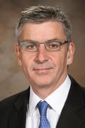
Dr. Lars Søndergaard, MD, MSc
Biography
Institution | Rigshospitalet (Copenhagen, Denmark)
Specialty | Professor of Cardiology; Consultant Cardiologist
Clinical Trials and Congress Organizations | Co-principal investigator for NOTION Trial for low-risk patients Conducted the first patient procedure in the SURTAVI Trial for intermediate-risk patients Course director and guest faculty for numerous congress organizations including the Transcatheter Cardiovascular Therapeutics (TCT)
TAVR Experience | Extensive TAVR implant and proctoring experiences; proctor experience in various Asian countries including Hong Kong, Singapore, Malaysia, Thailand, Taiwan and China Numerous publication of scientific papers on TAVR, including Valve-in-Valve cases

